Slide 1

Biological and Chemical Control of Noxious Weeds
Bill Walker
Territory Manager
Nutrient Ag Solutions
John Mortenson
Plant Protection Specialist
North Dakota Department of Agriculture

Slide 2
What is Biological Control?
Biological control, or biocontrol, is the use of natural enemies to control a noxious and invasive weed
Pros and Cons of Biocontrol
Pros | Cons
Cost effective | Time and money to develop
Plant specific | Limited supply of approved agents
Sustainable (subject to host density and | Does not always work
environmental conditions) | Time to build up populations that control the target weed Minimum of 3-5 years, can take up to 10 years
 | Does not eradicate the noxious weed Time, time, time

Slide 3
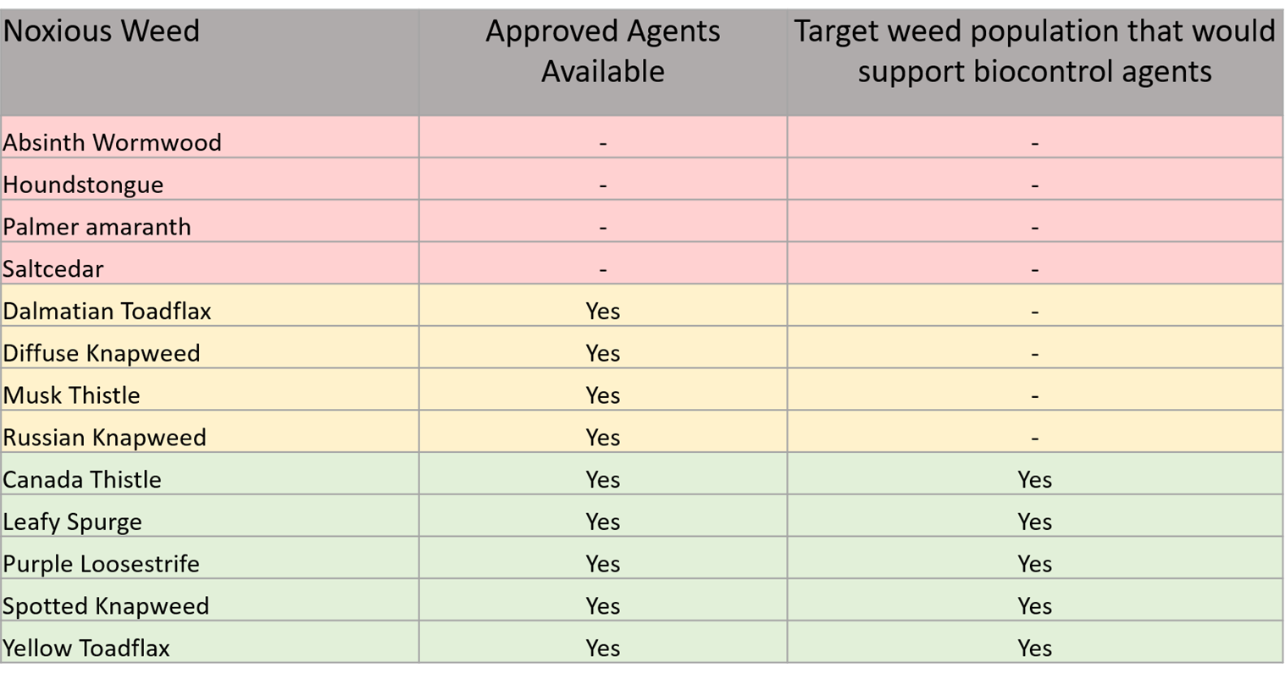
Biocontrol and Noxious Weeds of ND

Slide 4
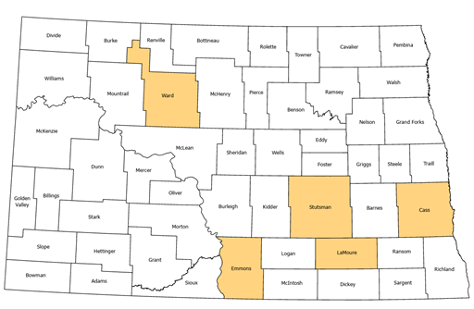
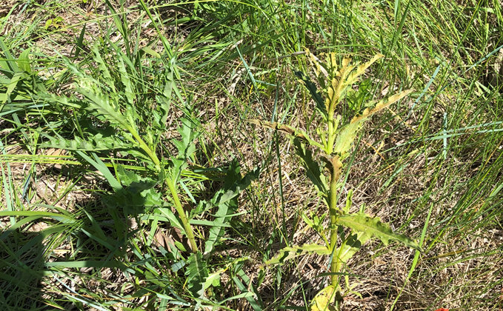
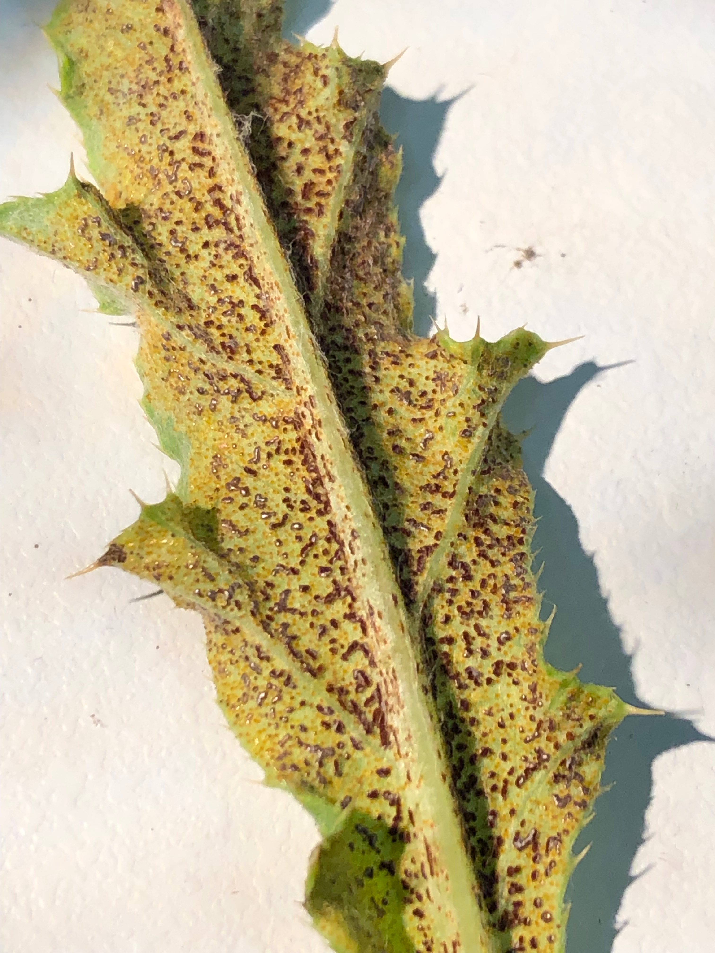
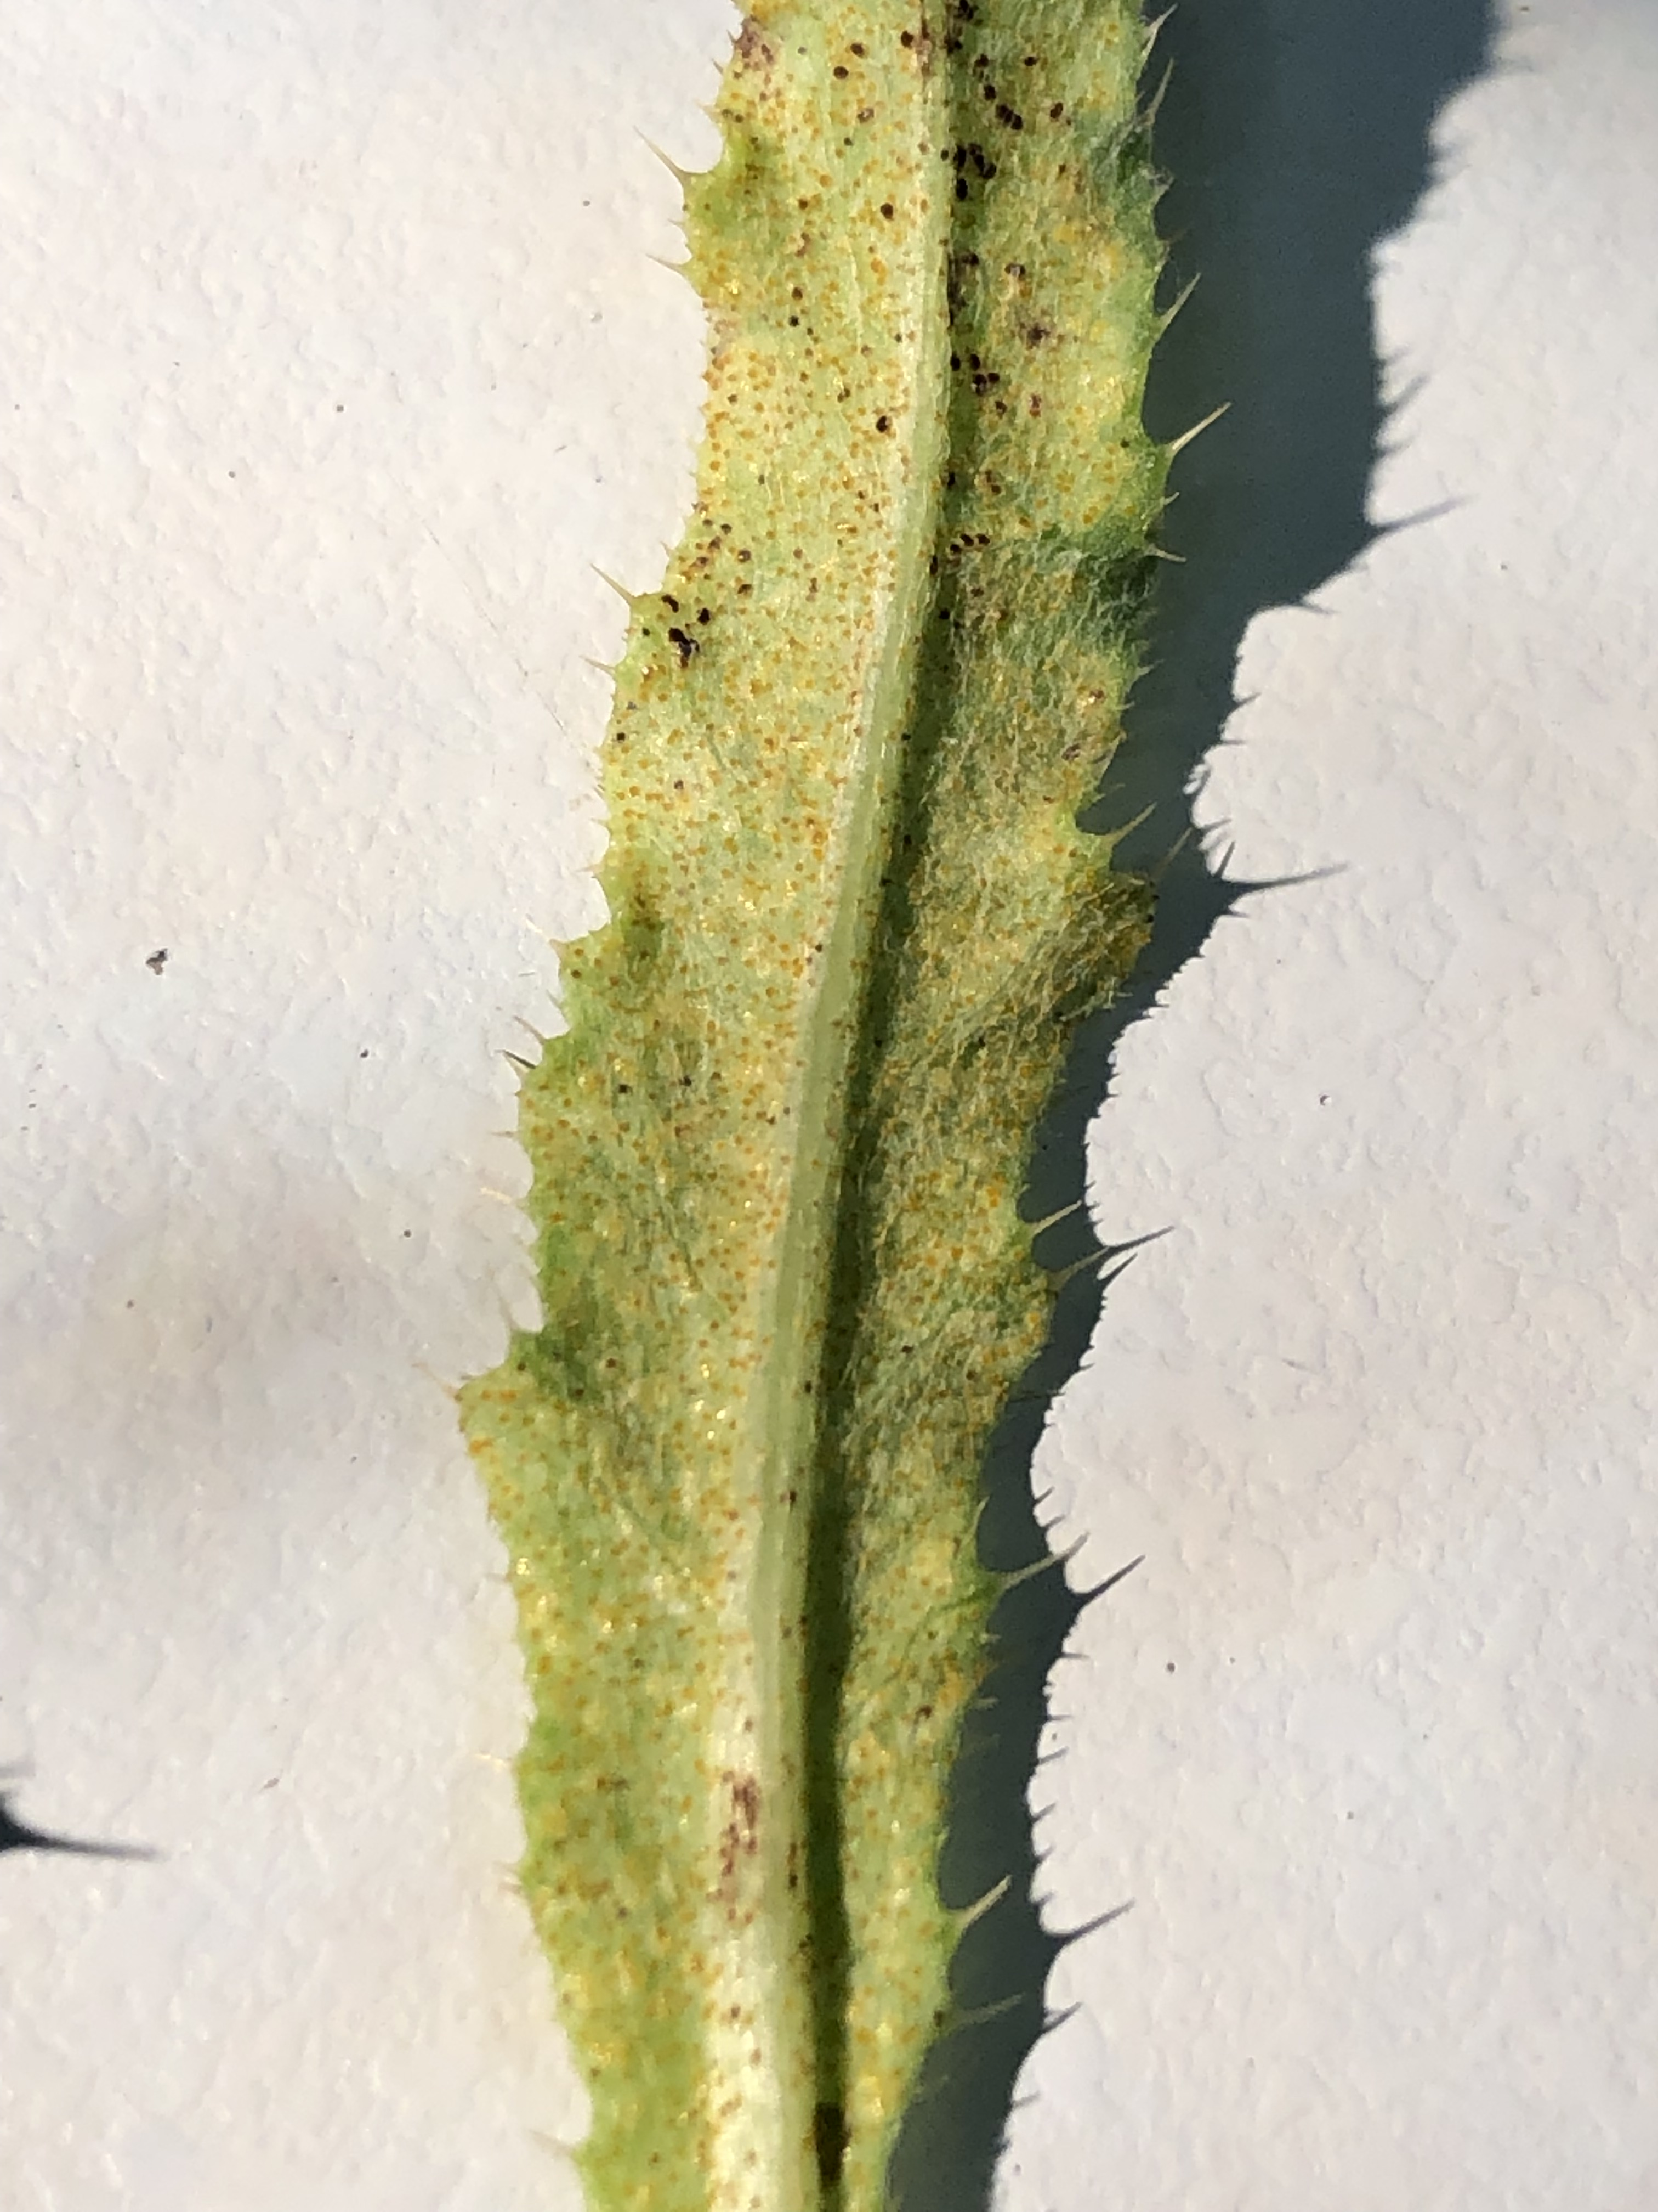
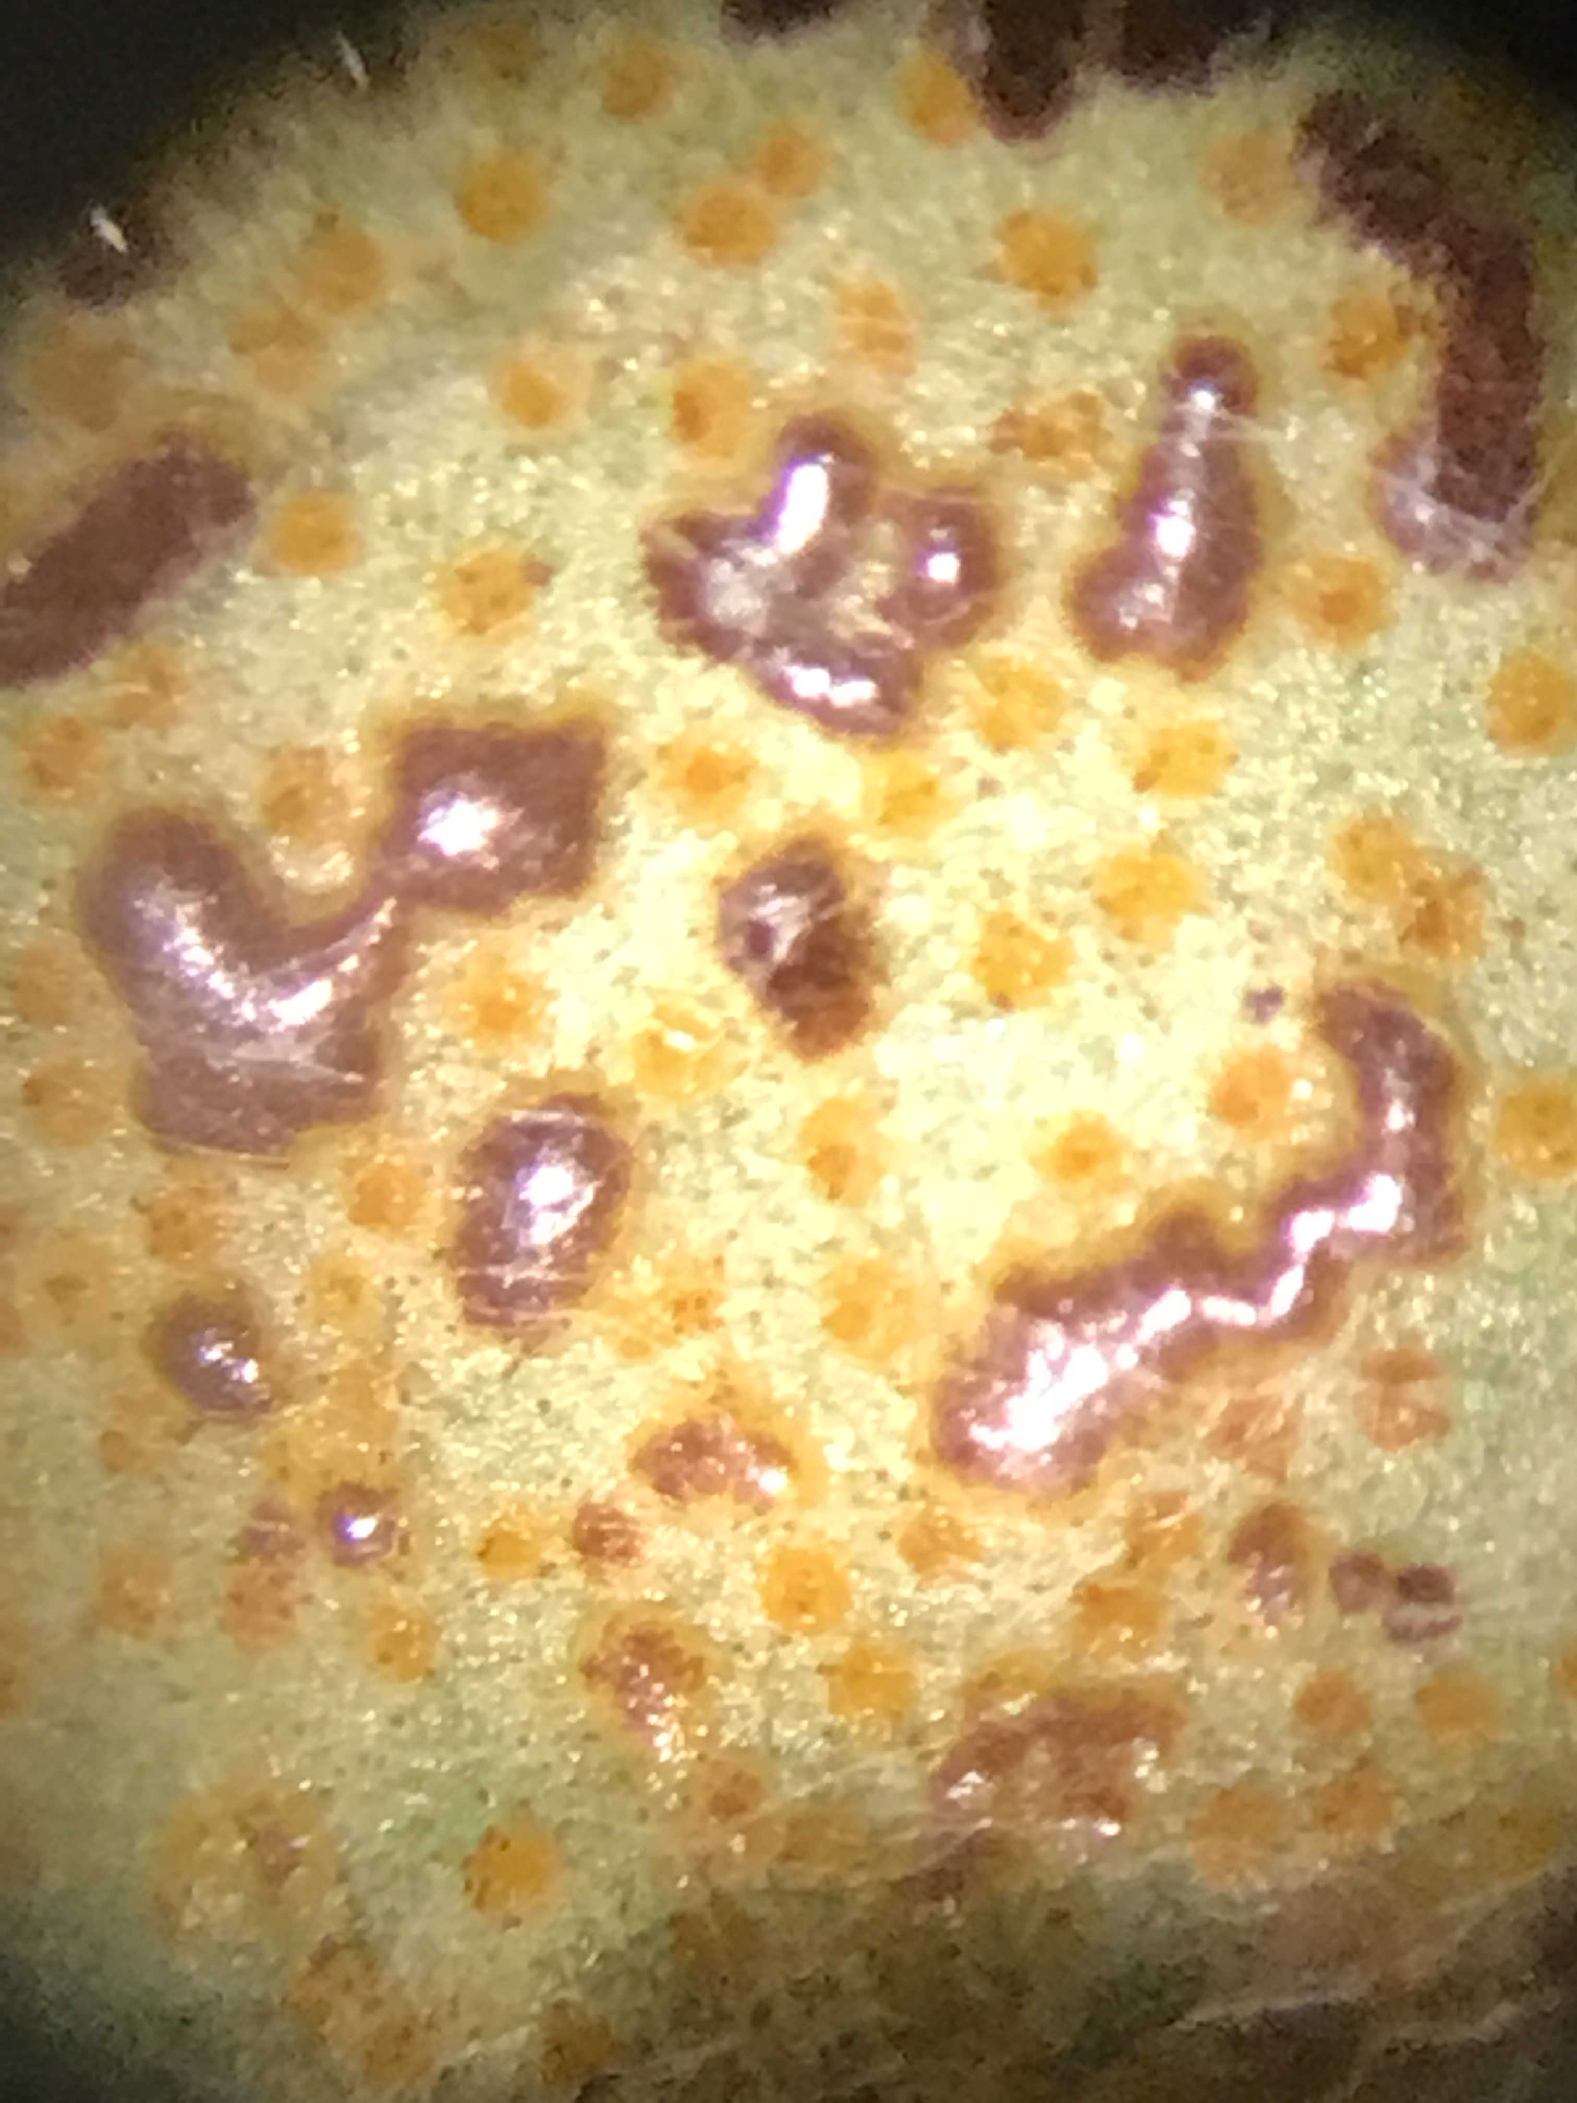
Canada Thistle Active Projects
Rust fungus
  6 research sites, 2 naturally occurring sites
  Waiting on APHIS/EPA to determine who regulates plant pathogen
Gall Fly and Stem Mining Weevil
  Ineffective at control
Healthy (left) and infected (right) Canada thistle plants
Photo credit: NDDA
Various spore stages of Canada thistle rust fungus
Photo credit: NDDA

Slide 5
Surfactant Type/Use
Using a good quality surfactant or penetrating type surfactant (90% or 100% NIS) at .25% by volume (1 quart per 100 gallons water) is normal labeled recommendations on many products
Some labels may recommend the use of MSO (Methylated Seed Oil) Surfactants
These (MSO) are normally used at per acre rates (1 to 2 pints) or if by volume then .50% to 1% by volume (2 quarts to 1 gallon per 100-gallon rates) depending upon application rates per acre
Remember – MSO Surfactant can increase non-target grass or non-target vegetation damages when used in dry or adverse weather conditions and grasses are already under stress
Non-Ionic penetrating surfactants can somewhat mimic MSO Surfactants with less grass damages, especially in adverse weather conditions

Slide 6
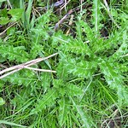
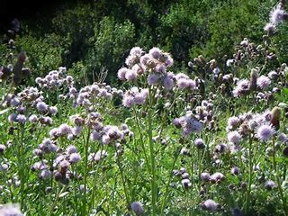
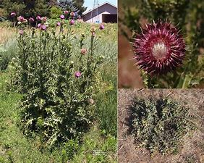
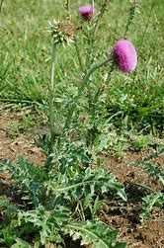
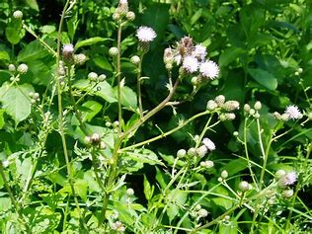
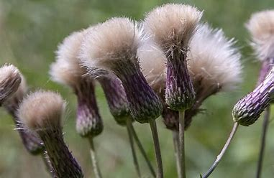
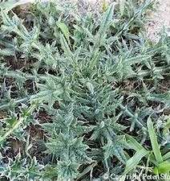
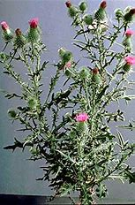
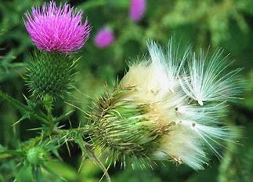
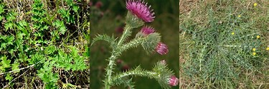
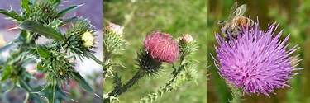
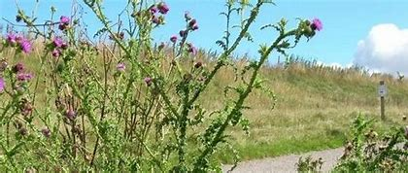
Thistles (All)
Canada Thistle
Musk Thistle
Bull Thistle
Plumeless Thistle

Slide 7
Canada Thistle, Musk Thistle, Bull Thistle, Plumeless – Herbicide Control
HighNoon or DuraCor Herbicides
Is a mixture of Milestone Herbicide (aminopyralid) and Rinskor Herbicide (florpyrauxifn-benzyl)
Use sites include but not limited to – rights-a-ways, roadsides, utility and electric power rights-of ways, railroads, storage areas, military sites, airports, gravel pits, industrial sites, natural areas including campgrounds, parks, prairie management, trailheads and trails, recreation areas, wildlife openings, wildlife habitat and management areas, CRP sites, rangeland sites, permanent grass pasture (including grasses grown for hay*), seasonally dry flood plains, deltas, marshes, prairie potholes or vernal pools including grazed areas in and around these sites.
DuraCor Herbicide does “NOT” have any right-a-way labeling other then a supplemental label allowing for limited right-a-way usage
**Does have the aminopyralid hay and Manure use restrictions like the Milestone Herbicide (consult the label for these)
Has no restrictions on grazing or grass hay harvesting after applications but they do request waiting 14 days after applications on hay harvesting (time for the product to work on treated plants)
Do not exceed 20 ounces per acre per year broadcast applications

Slide 8
HighNoon or DuraCor Herbicides can be used up to waters edge, “Do Not” apply directly to water or standing water, can not be used to treat vegetation standing in water
Take precautions to minimize incidental overspray to the adjacent water
Is permissible to treat target weeds within dry non-irrigation ditches and seasonally dry transitional areas between upland and lowland sites (such as flood plains, deltas, marshes, prairie potholes or vernal pools)
But only if those sites are forecasted to remain dry for 2 weeks following applications.
Use rates range from 12 to 20 ounces per acre for most all types of Thistle control with 16 ounces per acre being the most popular use rate (about 6 ounces Milestone equivalent)
HighNoon or DuraCor Herbicides will also help to improve brush control on species such as Alder, Aspen, Blackberry, Boxelder, Cherry, Conifers, Cottonwood, Elm, Maple, Poplar, Oak, Hackberry, Russian and autumn Olive, Salt Cedar and others when added to your brush control mixes
Additional Weeds – Palmer Amaranth (small plants), Teasel, Multiflora Rose, Japanese Knotweed, Poison Hemlock, Russian Knapweed, Perennial Sowthistle, Horse Nettle, Cocklebur, Wild Carrot, Buckhorn Plantain, Wild Sunflower

Slide 9
Use Rate for Bull, Musk and Plumeless Thistles
HighNoon or DuraCor Herbicide at 12 to 20 ounces per acre rates
Liberate Surfactant at 1 quart per 100 gallons water
In the spring to early summer to rosette or bolting plants or in the fall to seedlings and rosette plants, also apply
at 16 to 20 ounces per acre when plants are at late bolt through early flower growth stages
      and the addition of
Freelexx Herbicide at 1 quart (1 lb. ae) should be tank mixed with HighNoon or DuraCor Herbicides starting at late
bud stages to early flower stages on these plants to improve control (you gain Field Bindweed control with Freelexx added)
Use Rate for Canada Thistle
HighNoon or DuraCor Herbicides at 16 to 20 ounces per acre (most are using 20 ounces per acre rate)
Liberate Surfactant at 1 quart per 100 gallons water
In spring after all plants have fully emerged (some plants at this time may be budding) up until the oldest plants are in
full flower stage, use the higher rates when applying to the flower stage
HighNoon or DuraCor applications are also effective in the fall on new rosette and established plants before a killing frost
Use higher rates on older/dense stands for longer residual control
Spring and fall applications work well with HighNoon or DuraCor Herbicides

Slide 10
Canada Thistle, Musk Thistle, Bull Thistle, Plumeless – Herbicide Control
Milestone Herbicide at 5 to 7 ounces per acre
Liberate Surfactant at 1 quart per 100 gallons water
Addition of Freelexx Herbicide at 1 quart per acre can improve control on bolted and flowered plants
Greater than 10 gallons per acre is recommended for application rates for best control
Can be used to waters edge, do not apply directly to water or weeds standing in water, take precautions to minimize incidental overspray to adjacent water
While it does have some limited tree safety, I would not recommend overall spraying in tree belts or around trees and shrubs, Pines, Spruces, Hackberry’s and all legume species can be damaged or killed.

Slide 11
Canada Thistle, Musk Thistle, Bull Thistle, Plumeless Thistle
Transline Herbicide
Use sites include but not limited to – non-crop sites, forest sites, industrial manufacturing and
storage sites, rights-of-way such as roadsides, utility, railroads, wildlife openings, tree plantations,
Range and permanent grass pastures including grazed areas on these sites.
Can be used to waters edge but “DO NOT” apply directly to water, to areas where surface water is
Present, or to intertidal areas below the mean high-water mark.
Has no haying or grazing restrictions when used at labeled rates
Has supplemental labeling for use in, around and over the top applications on many tree species
(Ponderosa Pine, Scotch Pine, White Pine, Norway Spruce, Douglas Fir, Eastern and Western Red Cedar, White Spruce, Green Ash,
White Ash, Choke Cherry, Cherry, Cottonwood, Crab Apple, Hackberry, Sugar Maple, Bur Oak, Red Oak, White Oak,
Russian Olive, Sumac, Black Walnut and many more)
Do Not apply around or under legume species of trees or shrubs and is very active on legume
species of plants

Slide 12
Use Rates for Canada Thistle, Musk Thistle, Bull Thistle, Plumeless Thistle
Transline Herbicide at 12 to 21 ounces per acre
Liberate Surfactant at 1 quart per 100 gallons water
Non-Ionic surfactant should be added at 1 to 2 quarts per 100 gallons water (Liberate Surfactant)
Lower labeled rates can be used when weeds are no larger than 3” to 6” tall
Higher labeled rates should be used on these weeds listed above;
Canada Thistle should be at 16 to 21 ounces per acre rates when it is the primary weed for control
If you are dealing with Canada Thistle or any of these thistles in tree belts than Transline Herbicide could be a good choice here
Would be a safer choice in this situation than Milestone, HighNoon or DuraCor Herbicides
Again, watch applications around or under legume species of trees and shrubs
Additional Weeds – Russian Knapweed, Perennial Sowthistle, Common Teasel

Slide 13
Use Rates for Canada Thistle, Musk Thistle, Bull Thistle, Plumeless Thistle
Aquatic Sites or Wetland Type Sites
If applying close to or around water or wetland sites and are concerned about hitting the waters than you might consider one of the following programs
Freelexx Herbicide at 2 quarts per acre (has aquatic labeling)
Liberate Surfactant at 1 quart per 100 gallons water (has aquatic labeling)
Freelexx does have a very good aquatic label section in it’s label.
Opensight Herbicide at 3.3 ounces per acre
Pre-Mix of Milestone Herbicide and MSM Herbicide (Escort)
Liberate Surfactant at 1 quart per 100 gallons water
Opensight has a unique paragraph in it’s label
It is permissible to treat non-irrigation ditch banks, seasonally dry wetlands (such as flood plains, deltas, marshes, swamps, or bogs), and transitional areas between upland and lowland sites only when dry. Opensight can be used to waters edge, DO NOT apply directly to water and take precautions to minimize overspray to open water when treating target vegetation in and around non-flowing, quiescent, or transient water. When making applications to control unwanted plants on banks or shorelines of flowing water, minimize overspray to open water.

Slide 14
Use Rates for Canada Thistle, Musk Thistle, Bull Thistle, Plumeless Thistle
Aquatic Sites or Wetland Type Sites
AquaSweep Herbicide - could also be a choice for controlling these weeds as well as others around or in waters, can be used on but not limited to rangelands, pastures, non-irrigation ditch banks, roadsides, rights-a-ways, ornamental turf, as well as many aquatic sites
Is a mixture of 2,4-D amine and Triclopyr (amine formulation), has a very good aquatic label as well as terrestrial labeling, maximum of 5.5 pints per application, can do 2 applications per year with 30-day interval between (11 pints max per acre per year)
AquaSweep Herbicide at 5.5 pints per acre (88 ounces)
Liberate Surfactant at 1 quart per 100 gallons water (aquatic labeling)
Also has Multiflora Rose, Honeysuckle, Cocklebur, Docks, Field Bindweed, Plantains, Wild Carrot on label if these weeds are a problem in wet sites

Slide 15
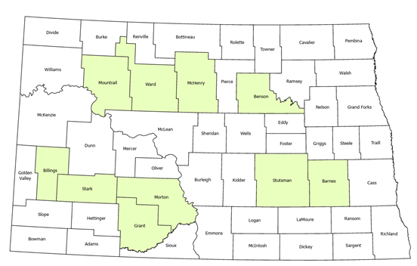
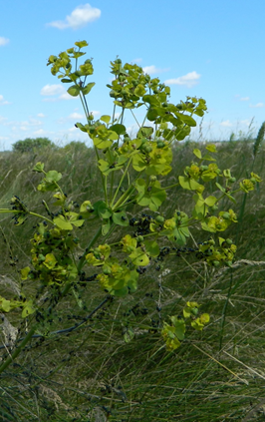
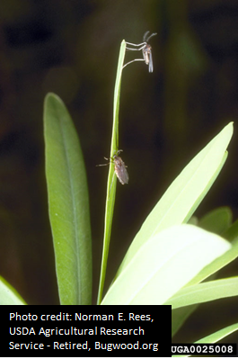
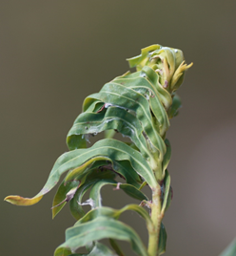
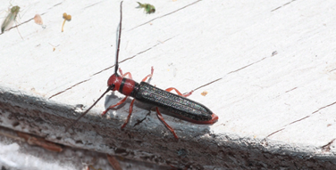
Leafy Spurge Active Projects
Green counties include boards that typically host a public field day and NDDA projects - many more projects by weed boards and land managers throughout ND
Flea beetles
  Works well when it establishes
  Does not work in sandy soils
  6 collection days in 2022
Stem boring beetle
  Insufficient numbers to decrease weed populations
Gall midge
  Decreases seed production
  Works best near wooded areas
  Needs to be combined with another control method
Leafy spurge flea beetles
Photo credit: NDDA
Leafy spurge stem boring beetle
Photo credit: NDDA
Leafy spurge gall midge
Photo credit: Norman E. Reese, USDA ARS-retired, Bugwood.org
Gall on top of leafy spurge
Photo credit: NDDA

Slide 16
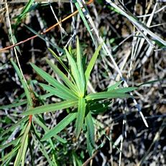
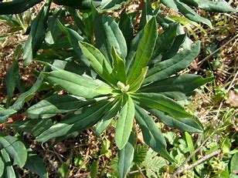
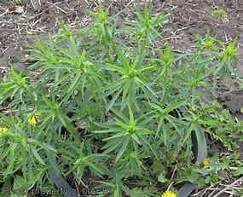
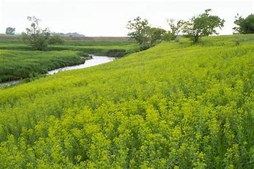
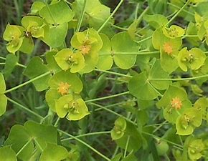
Leafy Spurge Herbicide Control

Slide 17
Leafy Spurge
Method 240 SL Herbicide - Method 240 SL Herbicide is a straight aminocyclopyrachlor (was the base product in Perspective or Streamline Herbicides)
Can be used on but not limited to - private, public and military lands, right-a-ways, fence rows, farmyards, natural areas such as wildlife management areas, wildlife openings, wildlife habitats, highways/roadsides, railroad, pipeline and utility rights-of-ways, non-irrigation ditch banks, restoration areas and unimproved industrial turf on these types of sites
Does have a haying and grazing restriction of 365 days from application date, is Caution labeled, is a non-restrictive use product, is currently the most positive Leafy Spurge control the we have seen
Method 240 SL Herbicide may be applied to terrestrial non-crop sites that contain areas of temporary surface water, caused by collection of water in equipment ruts or in other depressions created by management activities.
It is permissible to treat intermittently flooded low lying sites, seasonally dry flood plains, and transitional areas between upland and lowland sites when no water is present and is permissible to treat marshes, swamps and bogs after water has receded, as well as seasonally dry flood deltas.
Can be used to waters edge, take precautions to minimize overspray to open water when treating vegetation near water’s edge
Additional Weeds – Canada Thistle, Teasel, Field Bindweed, Musk Thistle, Bull Thistle, Sericea Lespedeza, Poison Hemlock, Honeysuckle, Horse Nettle, Russian Knapweed, Buckthorn, Cocklebur, Wild Carrot

Slide 18
Use Rate for Leafy Spurge
Method 240 SL Herbicide at 6 ounces to 8 ounces per acre
with most “NOT” going above 8 ounces per acre
Liberate Surfactant at 1 quart per 100 gallons water
(Liberate is a 100% non-ionic penetrating surfactant, replaces MSO)
Leafy Spurge has small leaves and stems so higher water volumes on applications help with better coverage and control (25 to 30 gallons per acre)
Applications are showing Leafy Spurge control for 2 to 3 years before re-treatments are necessary (may not be the case in all instances)
Will be tough on some species of trees and shrubs, be careful around these, especially spruce, pine, conifer species and legume species but no more than Tordon 22K Herbicide applications
Can be somewhat selective on some forbs and shrubs in treated areas as well

Slide 19
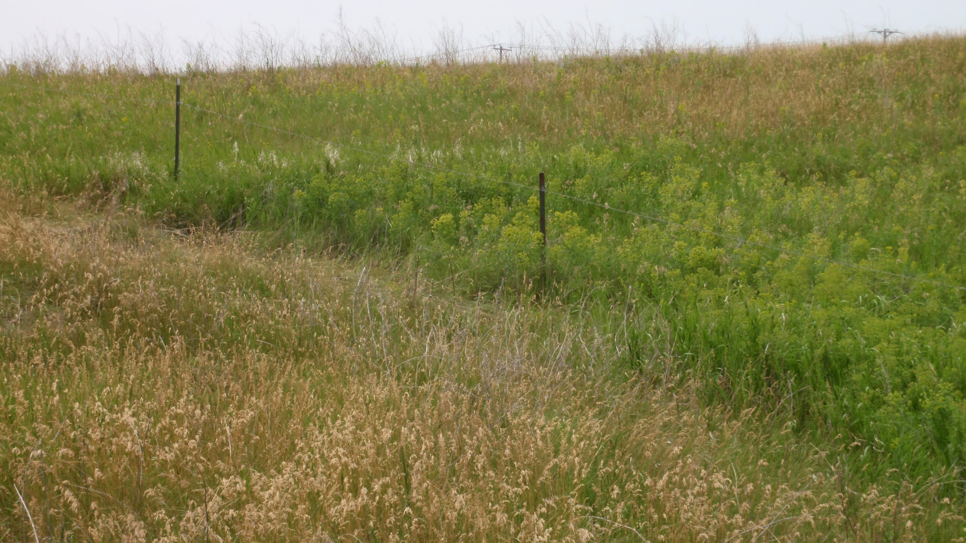
Stutsman County, ND – 1 year after treatment
Method 240 SL Herbicide - 8 ounces per acre
Liberate Surfactant – 1 quart per 100 gal. water
Dead Canes from old plants

Slide 20
Leafy Spurge
Plateau Herbicide - (Imazapic) – may be used on but not limited to CRP lands, noncropland areas including noncropland areas that may be used for haying and grazing, highways rights-a-way, utility, railroad, pipeline rights-a-ways, Non-agriculture Fence rows, storage areas, non-irrigation ditch banks, prairie sites, industrial turf and other sites as listed on the label
Is a Caution labeled product and is a non-restricted use product, can be used to waters edge but “Do Not” apply directly to water or to
Areas where surface water is present or to areas below the mean high-water mark
Many perennial grasses (especially warm season) are tolerant to Plateau, can stunt or damage cool season grasses at the higher rates
Many established forbs and wildflowers are tolerant to Plateau Herbicide at 4 ounce to 8 ounce per acre rates and some up to
12 ounce per acre rates
Many tree species have good tolerance to Plateau Herbicide for applications around and under, watch sandy soils when applying
near Cottonwood or Popular species, you will get more damage on these in the lighter soils
Do Not apply around or under Lilacs, you can severely injure or kill these
Will also give you control of many annual grasses in the treated sites
Additional Weeds – Cocklebur, Wild Mustard, Shattercane, Field Bindweed, Poison Hemlock, Russian Knapweed,
Common Teasel, Bull Thistle, Musk Thistle

Slide 21
Use Rate for Leafy Spurge
Plateau Herbicide at 8 to 12 ounces per acre
MSO Surfactant at 32 ounces (1 quart) per acre
Plateau at 8 ounces per acre being the most common rate used and safest on the grasses and surrounding vegetation
Fall applications only with this program starting sometime in mid to late August up until the Latex Sap in the plant dries up, if the sap is not present, don’t spray with Plateau
Spring Treatment - North Dakota mixture = 16 ounces (1 pint) Tordon 22K Herbicide, 4 ounces Plateau Herbicide, 16 ounces (1 pint) 2,4-D amine Herbicide and 1 quart MSO per acre, sometimes the 2,4-D amine is dropped out
Plateau and 2,4-D type products can be antagonistic (don’t play well together) so watch the mixing of these
If sandy or light soils, then consider dropping rate down to 6 ounces Plateau per acre rates
When applied properly will give approximately 2 years or so control of Leafy Spurge
High-rate applications can and will cause grass damages and grass suppression in the next years spring, especially if grasses are already under stress

Slide 22
Leafy Spurge
Facet L Herbicide – (Quinclorac) may be used on Rights-of-ways, Roadsides, Fence lines, Pastures,
(Including pasture grown for hay), CRP and has crops labeling as well
Can be applied to waters edge, DO NOT apply directly or indirectly to water, areas where surface water is present,
or to intertidal areas below the mean high-water mark
Facet L Herbicide does have good safety around and under trees, good for tree belts with Leafy Spurge
Problems, will also help in controlling Field Bindweed and Canada Thistle (somewhat) in these sites
Is very slow to show symptoms and may not be evident for several weeks after application and full effect
may not be evident for 3 to 6 months on perennial weeds
Facet L Herbicide is used in some sensitive sites where Prairie Orchid is present in North Dakota
(Sheyenne National Grass Lands)
Application with Facet L can be expensive and cost up to $60.00 plus per acre
Additional Weeds – Field Bindweed, Canada Thistle,

Slide 23
Use Rate for Leafy Spurge
Facet L Herbicide at 32** to 64 ounces per acre
MSO Surfactant at 32 ounces per acre
Most use the 48 to 64 ounce per acre rates for Leafy Spurge control
If applying Facet L at the **32 ounce per acre rates than it is suggested to add Overdrive Herbicide at 4 to 6 ounces per acre as well
If you add Overdrive Herbicide (dicamba based herbicide), you will lose the tree safety and you might have to deal with possible volatility issues from the dicamba as well near sensitive crops
Apply in spring at yellow bract growth stage (prebloom or before true flower)
Apply in fall before the first killing frost and latex is still flowing in the Leafy Spurge

Slide 24
Leafy Spurge with Venue Herbicide
Something a bit new to look at – Venue Herbicide on Leafy Spurge
Venue® Herbicide provides powerful control of leafy spurge in pasture, rangeland, and non-cropland. The active ingredient, pyraflufen-ethyl, is a PPO inhibitor which is a unique mode of action for control of leafy spurge. Research shows that Venue tank mixed with 2,4-D controls heavy leafy spurge populations when applied once per season in early June for three consecutive years.
Use Information
• Venue Rates- 3.5 fl. oz/A on pasture and rangeland- 4.0 fl. oz/A on non-crop
• Apply with 2,4-D at 1 lb. acid equivalent per acre (Working with Freelexx Herbicide currently)
• Use COC or MSO at 1% v/v, also doing work with Liberate Surfactant at .25% by volume
• Apply late spring/early summer at yellow-bract stage, often late May or early June depending on geography.
• Repeat application yearly to achieve full control of leafy spurge.
• Spray solution should have a pH of 7.5 or less. Buffer if necessary.

Slide 25
Key Benefits
• Control of leafy spurge can be achieved after three consecutive yearly applications.
• Excellent fit for riparien zones, Very good tree safety
• No grazing restrictions (once spray solution is dried)
• Minimal impact to grasses and trees
• Novel Group 14 herbicide providing a rotational option for leafy spurge control
• Provides additional control of field bindweed and Russian thistle (less than 4 inches)
Product Information
• For optimum results, late spring/early summer applications are recommended to reduce leafy spurge competition with desirable vegetation during the summer growing months.
• Leafy spurge will become symptomatic within 3 days and full desiccation can be expected within 1 to 2 weeks.
• Three consecutive yearly applications are needed for complete control of leafy spurge. After year three, occasional spot applications may be needed to eradicate leafy spurge.
• Venue is a contact herbicide. Higher carrier volumes will result in better control.

Slide 26
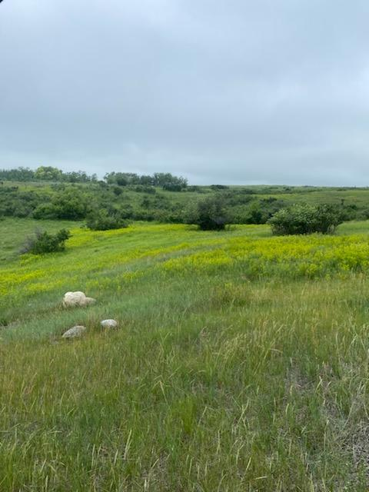
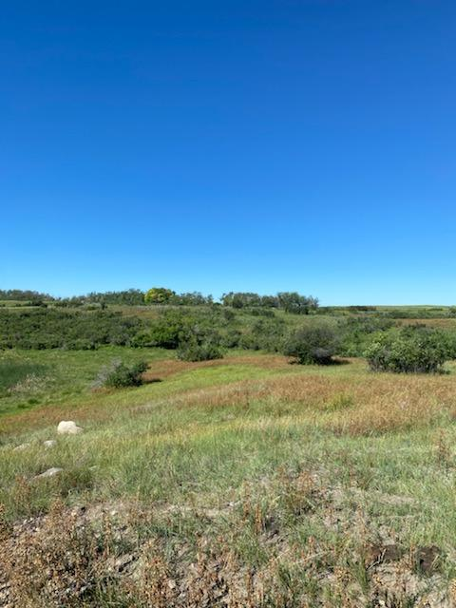
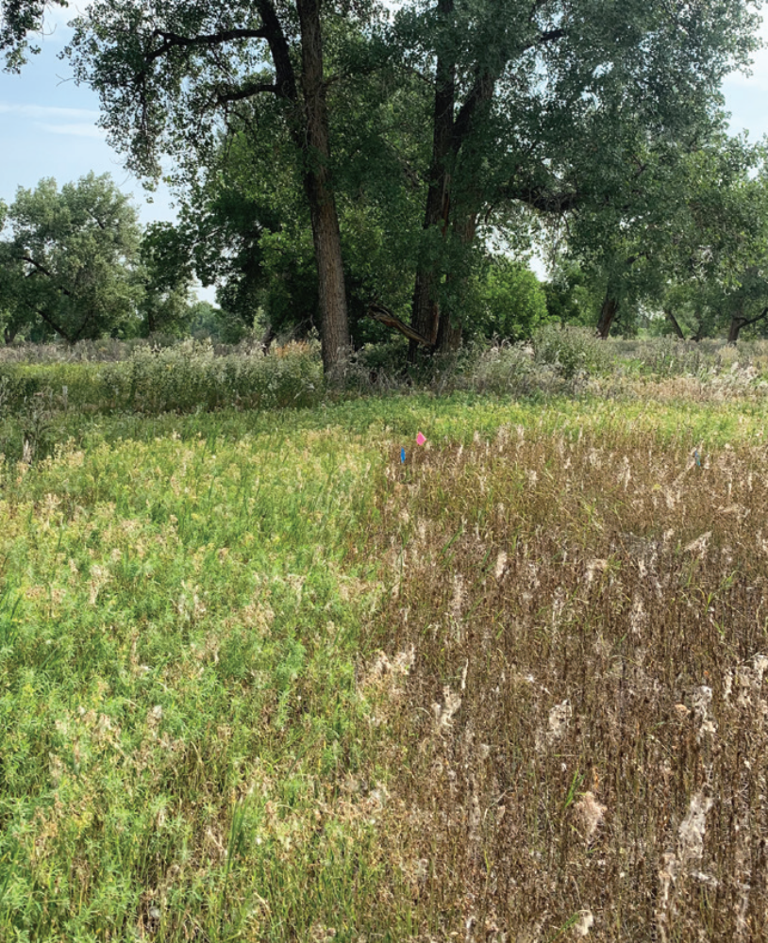
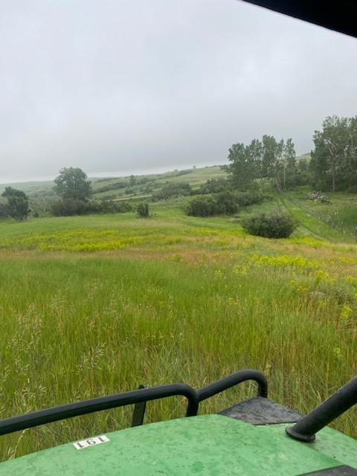
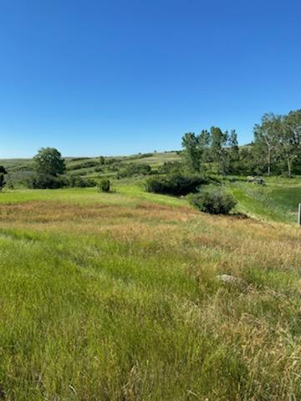
Efficacy of Venue + 2,4-D on Leafy Spurge
28 Days After Treatment
Montrail County, ND
2022 Venue Plots
9 days after treatment
4 oz Venue, 1 qt. Freelexx
MSO? Or Liberate?

Slide 27
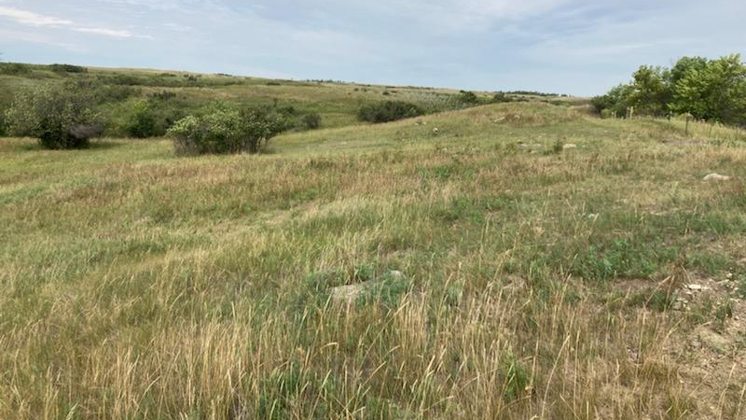
Photos – August 18, 2022
Venue Test Plots, Montrail County, ND
Applied approximately July 5, 2022

Slide 28
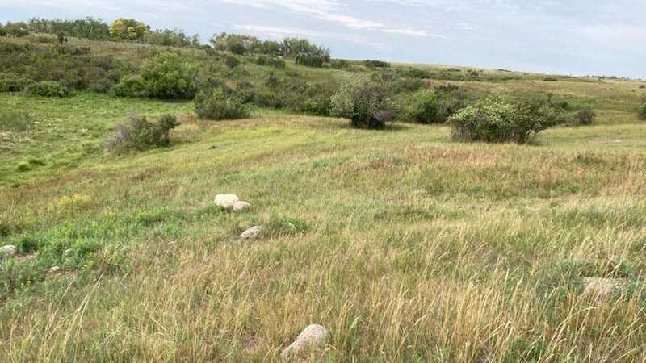
Photos – August 18, 2022
Venue Test Plots, Montrail County, ND
Applied approximately July 5, 2022

Slide 29
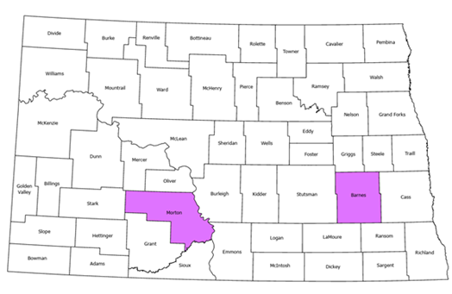
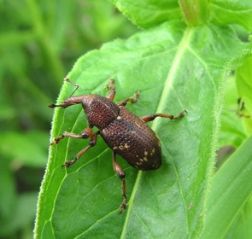
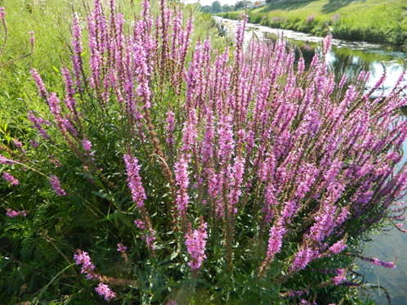
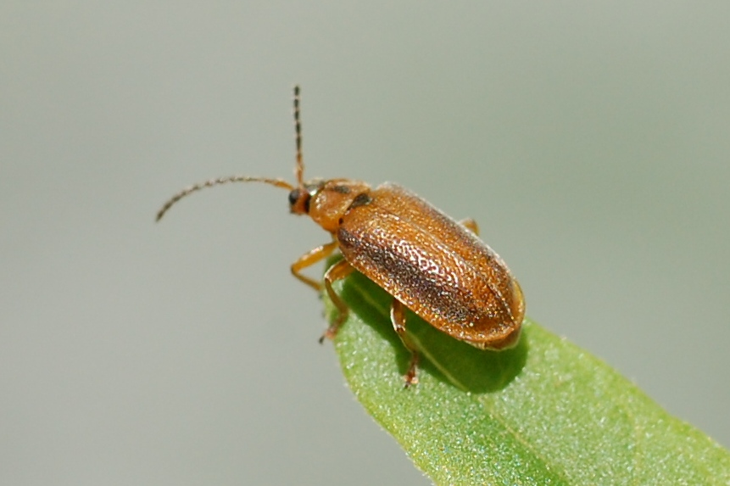
Purple Loosestrife Active Projects
Leaf feeding beetles and root weevils
  Releases the last few years in Morton and Barnes Co
Seed weevil
  Not released in ND but possible release in 2023 if available
Leaf feeding beetle
Photo credit: Katrina Scheiner, USFWS
Root weevil
Photo credit: Washington State University, Integrated Weed Control Project
Purple loosestrife
Photo credit: NDDA

Slide 30
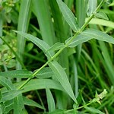
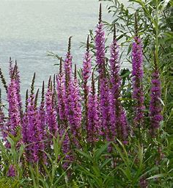
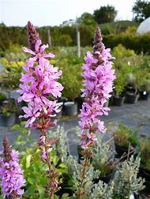
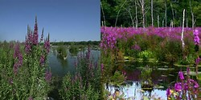
Purple Loosestrife Herbicide Control

Slide 31
Purple Loosestrife - is normally found in aquatic or riparian type sites
This makes control with our normal arsenal of herbicides difficult
Most of these do not have the aquatic labeling needed to spray into the waters
And some you must leave a buffer around or near water
Aquatic glyphosate products, 2,4-D products with aquatic labeling, triclopyr’s with aquatic labeling
or products that could be used to waters edge with some allowances for overspray into the waters
Is what we must look at for Purple Loosestrife control.
Roundup Custom, AquaNeat, Others, (aquatic glyphosates),
Freelexx Herbicide, most 2,4-D amine products with aquatic labeling
Vastlan Herbicide, Garlon 3A or Element 3A Herbicides (triclopyr’s)
Aquasweep Herbicide (Pre-Mix of 2,4-D amine and triclopyr)
These would be our main product choices for herbicide control Of this plant.

Slide 32
Vastlan Herbicide - Purple Loosestrife (Lythrum salicaria)
Purple loosestrife can be controlled with foliar applications of Vastlan Herbicide that is in and around standing
Water sites, such as marshes, wetlands, and the banks of ponds and lakes and transition areas between
Upland and lowland sites.
For broadcast applications, use a minimum of 4.5 to 6 quarts of Vastlan per acre, if site is grazed than
2 quarts per acre Vastlan, here are “NO” restrictions of livestock consumption of water in applied sites.
Apply Vastlan when purple loosestrife is at the bud to mid-flowering stage of growth.
Follow-up applications for control of regrowth should be made the following year in order to
achieve increased control of this weed species.
For all applications, a non-ionic surfactant should be added to the spray mixture
(preferably aquatic labeled)
Thorough wetting of the foliage and stems is necessary to achieve satisfactory control, top to bottom.
A minimum spray volume of 50 gallons per acre is needed for ground broadcast applications.
If using a backpack sprayer, a spray mixture containing 1% to 1.5% Vastlan or 5 to 7.6 fl. oz
of Vastlan per 4 gallons of water should be used. All purple loosestrife plants should be thoroughly wetted.
Additional weeds controlled, Bindweed, Canada Thistle, other thistles, Poison Ivy

Slide 33
Purple Loosestrife
Vastlan Herbicide at 5.5 to 6 quarts per acre
Liberate Surfactant at 1 quart per 100 gallons water
Spray plants top to bottom, higher application (water/carrier) rates are required
The addition of 1 to 2 quarts per acre of Freelexx Herbicide will help with improved control
Other Triclopyr products could be used as well, Garlon 3A or Element 3A Herbicides
Garlon 3A or Element 3A Herbicide at 6 to 8 quarts per acre
Liberate Surfactant at 1 quart per 100 gallons water
Again, spray plants top to bottom, higher application (water/carrier) rates are required.
The addition of 1 to 2 quarts or Freelexx Herbicide will help improve control
If using a backpack sprayer, then 1% to 1.5% Garlon 3A solution by volume or 5 to 7.6 ounces per 4 gallons water should be used, again, full coverage if possible

Slide 34
AquaSweep Herbicide – For use on Rangelands, Pastures, Fencerows, non-irrigation ditch banks,
Roadsides, and for control of – Emergent, Floating and Submerged aquatic weeds in the
following aquatic sites: Ponds, Lakes, Reservoirs, Marshes, Bayous, Non-Irrigation Canals and
Ditches, Seasonal Irrigation Canals and Ditches (which have little of no continuous outflow),
And Impounded Rivers and Streams that are quiescent or slow moving.
Aquasweep Herbicide is a pre-mix of 2,4-D amine and triclopyr (3A type product)
Purple Loosestrife application rates
Aquasweep Herbicide at 88 ounces per acre
Liberate Surfactant at 1 quart per 100 gallons water (aquatic labeled)
Spray plants to fully wet, higher water rates will give better control
There are no restrictions on the use of treated water for fishing, Do not swim in treated water for
3 hours after applications, there are no restrictions on consumption of treated water for potable
Use by livestock, pets or other animals.
Cross stream spray in “Not” permitted, when spraying shoreline weeds try to keep overspray on to the water no more than 2 feet

Slide 35
Glyphosate Products
If around aquatic sites or water than use the following
Roundup Custom at 1 gallon per 100 gallons water (or any aquatic labeled glyphosate)
LI 700 Surfactant at 2 quarts per 100 gallons water (acidifying / penetrating surfactant)
Choice weather Master at 2 quarts per 100 gallons water (water conditioner)
Reign at 1 quart per 100 gallons water (drift control and deposition aid)
If not around aquatic sites or water
Roundup Pro Concentrate at 1 gallon per 100 gallons water (or any aquatic labeled glyphosate)
LI 700 Surfactant at 2 quarts per 100 gallons water
Choice weather Master at 2 quarts per 100 gallons water
Reign at 1 quart per 100 gallons water
Should be applied with high water volumes for through plant coverages, 100 gallons per acre plus, if plants are over 4 ft. tall than you will have to use column acres as well as ground acres for good control and to figure applications
Can do restoration projects sooner with this program
Can be safe around and under trees, keep off green foliage, thin bark trees and any suckers at base of trees

Slide 36
Purple Loosestrife:
Arsenal Herbicide (Imazapyr) at 3 to 4 pints per acre
MSO Surfactant at 2 pints per acre or 1% solution by volume
(1 gallon per 100 gallons if using high volume spraying)
Arsenal does have aquatic labeling if applications are near or in water, will be very positive for control but will kill everything it hits or drifts on with a longer residual than glyphosates
Results can be slow and take up to weeks to show full effects, sites might be limited as to where Arsenal applications could be used
If looking at restoration after applications than that might be up to 2 plus years later
Make sure your MSO does have aquatic labeling, some do not.

Slide 37
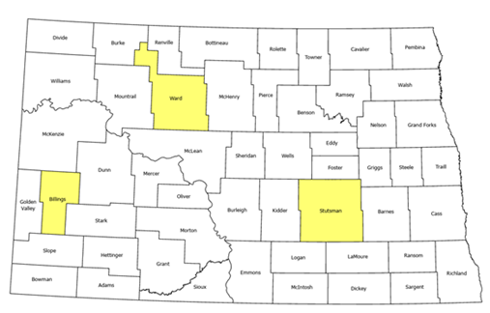
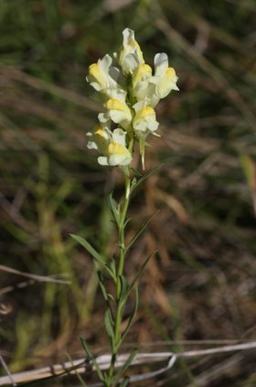
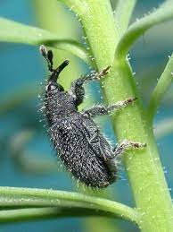
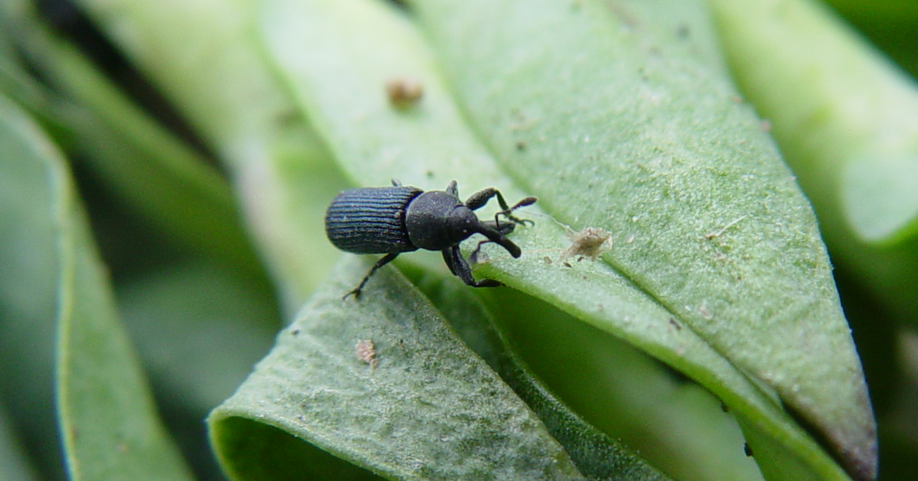
Yellow Toadflax Active Projects
Stem mining weevil
  Release sites in Ward Co since 2013
  Release in Stutsman Co started in 2019
Stem galling weevil
  Release in Billings Co in 2021
Stem mining weevil
Photo credit: NDDA
Stem galling weevil
Photo credit: U.S. Forest Service, Rocky Mountain Research Station
Yellow toadflax
Photo credit: NDDA

Slide 38
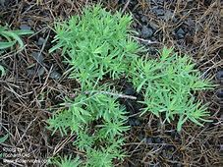
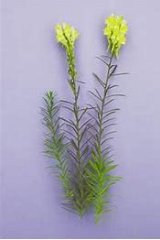



Yellow Toadflax Herbicide Control

Slide 39
Yellow Toadflax Herbicide Control
Yellow Toadflax - is difficult to control, limited herbicides work, herbicide rates need to be at max labeled rates for best results, small leaves for herbicides to attach to.
Some of our best results had been with a product called –Perspective Herbicide - (no longer made), using 8 ounces per acre gave us good control.
Perspective Herbicide was a pre-mix of Method 240 SL Herbicide and Telar XP Herbicide.
We also had some good early plot results in Ward County, ND with Escalade 2 Herbicide, now E-2 Herbicide at 4 to 5 pints per acre as well, if in towns or turf Escalade 2 Herbicide could be used.
Use of a silicone surfactant (super wetters) or penetrating surfactants (like Liberate) help with coverage and penetrating into this plant.
With this being said, herbicide suggestions would be as follows

Slide 40
Yellow Toadflax
Tordon 22K Herbicide at 2 quarts per acre
Escort XP Herbicide at 1.5 ounces per acre
Liberate Surfactant at 1 quart per 100 gallons water (penetrating surfactant)
Or Freeway Surfactant at 1 pint per 100 gallons water (Silicone Surfactant)
Higher application rates (water/carrier) will improve coverage and control, 25 plus gallons per acre rates would be best.
With Tordon 22K Herbicide at this rate expect some grass damage or discoloration, Escort XP will add to this damage as well.
Cannot be used around or under any trees or shrubs or inner-city as well, if staying under the 1.66 ounces of Escort XP than there would be no grazing restrictions as well
Max rate on Escort XP for range and pasture and grazed sites would be the 1.66 ounces per acre per year.
Tordon 22K rate is maxed so any additional applications in that site would have to be different products.

Slide 41
Yellow Toadflax
Perspective Herbicide – 8 ounces per acre ???
Well not anymore but let’s make it using Method 240 SL Herbicide and Telar Herbicide.
For each ounce of Perspective, you would need 1.5 ounces Method and 0.15 ounces Telar
Method 240 SL Herbicide at 8 ounces per acre (12 ounces would be a bit tough on the grasses)
Telar XP Herbicide at 1.5 ounces per acre
Liberate Surfactant at 1 quart per 100 gallons water (penetrating surfactant)
Or Freeway Surfactant at 16 ounces per 100 gallons water (silicone surfactant)
Higher application rates (water/carrier) will improve coverage and control, 25 plus gallons per acre rates would be best.
Has no haying or grazing labeling so limited use in areas where grazed or hayed
Has a supplemental label that does allow for applications to right-a-ways that transect grazed sites with no grazing restrictions on these, but still no haying
Will be tough on some species of trees and shrubs, be careful around these, especially spruce, pine, conifer species and legume species but no more than Tordon 22K Herbicide applications
Can be used to waters edge with both products

Slide 42
Yellow Toadflax
E-2 Herbicide – is a pre-mix of 2,4-D amine, dicamba and fluroxypyr (Vista), has all range and pasture, Right-a-Ways, Roadsides, Industrial Sites, Recreational Areas, CRP and Similar Non-Crop areas.
No grazing restrictions for non-lactating animals, do not grazed lactating animals for 7 days, no haying for 7 days after applications
Use rates are from 2 to 5 pints per acre rates, recommended for Yellow Toadflax at 4 to 5 pints per acre rates and possibly add Escort XP Herbicide at 1 to 1.5 ounces per acre rates
E-2 Herbicide at 4 to 5 pints per acre
Escort XP Herbicide at 1 to 1.5 ounces per acre
Liberate Surfactant at 1 quart per 100 gallons water (penetrating surfactant)
Or Freeway Surfactant at 16 ounces per 100 gallons water (silicone Surfactant)
Higher application rates (water/carrier) will improve coverage and control, 25 plus gallons per acre rates would be best.
Could be used on rough turf sites but not fine turf sites, use Escalade 2 Herbicide on fine turf sites at the 3 to 4 pints per acre rates.
Max use rate per acre per year is 2 applications of 5 pints per acre, must be applied a minimum of 21 days apart

Slide 43





Spotted Knapweed Active Projects
Root weevil
  Released in 2013, plans to release in 2023
Flower weevils
  Released in 2013 and established, found again in 2021
Spotted knapweed flower weevil
Photo credit: NDDA
Spotted knapweed root weevil
Photo credit: Laura Parsons, University of Idaho, PSES, Bugwood.org
Spotted knapweed
Photo credit: NDDA

Slide 44





Spotted Knapweed

Slide 45
Spotted Knapweed
Spotted Knapweed is probably the easiest of the Knapweeds to control but can also be the most prolific or the 3
Milestone, DuraCor, HighNoon, Opensight all work well on it, E-2 has it labeled as well and the old standby of Tordon and 2,4-D
Spring rosette applications work well and late fall applications to new rosettes, in fall applications 2 to 3 quarts of 2,4-D amine have worked for very good control in sensitive sites
Once it starts to bolt and flower you will have to increase product rates for better control
Leaf structure is broader making it easier to get products into the plants
Spotted Knapweed and Knapweeds will put a toxin into the soils around them reducing other vegetation from growing, may take a year or so after eliminating for other vegetation to grow again

Slide 46
Spotted Knapweed
Tordon 22K Herbicide at 1 pint per acre
2,4-D Amine at 1 quart per acre
Liberate Surfactant at 1 quart per 100 gal. water
If Spotted Knapweed has bolted and started to flower increase Tordon 22K to 2 pints per acre
Freelexx Herbicide could be used in place of 2,4-D Amine Herbicide, should give some better intake on later bolted or flowered plants
Good for open areas, range and pasture, hay grounds and others
Stay away from valuable trees and shrubs, can kill these if sprayed over roots zones, buffer strips along water, use a setback there as well
The old normal spraying program for Spotted Knapweed

Slide 47
Spotted Knapweed
HighNoon Herbicide
Or
DuraCor Herbicide at 12 to 16 ounces per acre
Liberate Surfactant at 1 quart per 100 gallons water
Both work very well on Spotted Knapweed, both are a pre-mix of Milestone Herbicide and Rinskor, max use rate is 20 ounces per acre
HighNoon or DuraCor Herbicides can be used up to waters edge, “Do Not” apply directly to water or standing water, can not be used to treat vegetation standing in water
Take precautions to minimize incidental overspray to the adjacent water, shoreline weeds allow no more than 2-foot overspray onto the water
Has no restrictions on grazing or grass hay harvesting after applications but they do request waiting 14 days after applications on hay harvesting (time for the product to work on treated plants)

Slide 48
Spotted Knapweed
Milestone Herbicide at 5 ounces (rosette) 7 ounces at bolt to flower
Liberate Surfactant at 1 quart per 100 gallons water
Addition of Freelexx Herbicide at 1 quart per acre can improve control on bolted and flowered plants
Higher rates will also pickup Diffused and Russian Knapweeds
Greater than 10 gallons per acre is recommended for application rates for best control
Can be used to waters edge, do not apply directly to water or weeds standing in water, take precautions to minimize incidental overspray to adjacent water
While it does have some limited tree safety, I would not recommend overall spraying in tree belts or around trees and shrubs, Pines, Spruces, Hackberry’s and all legume species can be damaged or killed.

Slide 49
Spotted Knapweed
Transline Herbicide at 1 to 1and 2/3 pints per acre (16 to 20 ounces)
Liberate Surfactant at 1 quart per 100 gallons water
Lower labeled rates can be used when weeds are no larger than 3” to 6” tall
Higher labeled rates should be used on weeds above 6” tall or taller
If you are dealing with Spotted Knapweed or any of the Knapweeds in tree belts than Transline Herbicide could be a good choice here
Would be a safer choice in this situation than Milestone, HighNoon or DuraCor Herbicides
Again, watch applications around or under legume species of trees and shrubs
Additional Weeds – Russian Knapweed, Perennial Sowthistle, Common Teasel

Slide 50
Spotted Knapweed
E-2 Herbicide at 3 to 4 pints per acre
Liberate Surfactant at 1 quart per 100 gallons water
Higher application rates (water/carrier) will improve coverage and control, 25 plus gallons per acre rates would be best.
Could be used on rough turf sites but not fine turf sites, use Escalade 2 Herbicide on fine turf sites at the 3 to 4 pints per acre rates if Spotted Knapweed is in those sites
Max use rate per acre per year is 2 applications of 5 pints per acre, must be applied a minimum of 21 days apart
No grazing restrictions for non-lactating animals, do not grazed lactating animals for 7 days, no haying for 7 days after applications
Has some safety around and under trees and shrubs, and can be used up to water’s edge, no overspray into the water, edge only
Special Note: Spotted Knapweed is not that difficult to control if on it early and in rosette stages
Freelexx Herbicide, 2,4-D amine or Esters, dicamba’s and dicamba’s + 2,4-D can all do a decent job of Spotted Knapweed control, it’s the Russian and Diffused Knapweeds that are much harder to control.

Slide 51
Questions?
John Mortenson
  701-226-8804
  jmortenson@nd.gov

